Slide 1
INTERNACIONAL MOBILITY 2023-2024 (Autumn Semester)
Welcome to the Faculty of Law of the University of Girona.

Slide 2
Academic Secretary
Marta Juanhuix
secretaria.dretieconomiques@udg.edu
Faculty of Economics
C. Universitat de Girona, 10
Campus Montilivi
17003 Girona
Tel. +0034 972 418002
Vice-dean
Diego M. Papayannis
diegomartin.Papayannis@udg.edu

Slide 3
Office Schedule Academic Secretary Office Faculty of Economics
Monday to Friday from 9:30 to 13:45 – Marta Juanhuix
I work at the office – Faculty of Economics, from Tuesday to Friday
From October 1st to June 30th Monday only by email

Slide 4
Academic Calendar (Autumn 2023-2024)
CLASSES: from 12/09/2023 to 23/12/2023 (both included)
HOLIDAYS:
- Christmas: from 24/12/2023 to 06/01/2024 (both included)
- Spanish Festivity: 12/10/2023
- Sant Narcís Festivity: 30 and 31/10/2023
- Constitutional Day: 06/12/2023
EXAM PERIOD:
- From 08/01/2024 to 02/02/2024
- FIRST ROUND: from 08/01/2024 to 19/01/2024
- SECOND ROUND: from 22/01/2024 to 02/02/2024

Slide 5
Academic Calendar (Spring 2023)
CLASSES: from 05/02/2024 to 17/05/2024 (both included)
HOLIDAYS:
- Easter: from 25/03/2024 to 01/04/2024 (both included)
- UdG Day: 19/04/2024
- 01/05/2024 Worker day
EXAM PERIOD:
- From 20/05/2024 to 21/06/2024
- FIRST ROUND: from 20/05/2024 to 31/05/2024
- SECOND ROUND: from 03/06/2024 to 21/06/2024
https://www.udg.edu/ca/fd/informacio-academica/horaris-i-examens

Slide 6
Documentation
LEARNING AGREEMENT
Changes form
DISCLAIMER OF RESPONSIBILITY (in case you don’t need Insurance from Udg because you have it)
INSURANCE
You can find information about insurance from UdG in the website https://www.udg.edu/ca/viu/serveis-universitaris/assegurances

Slide 7
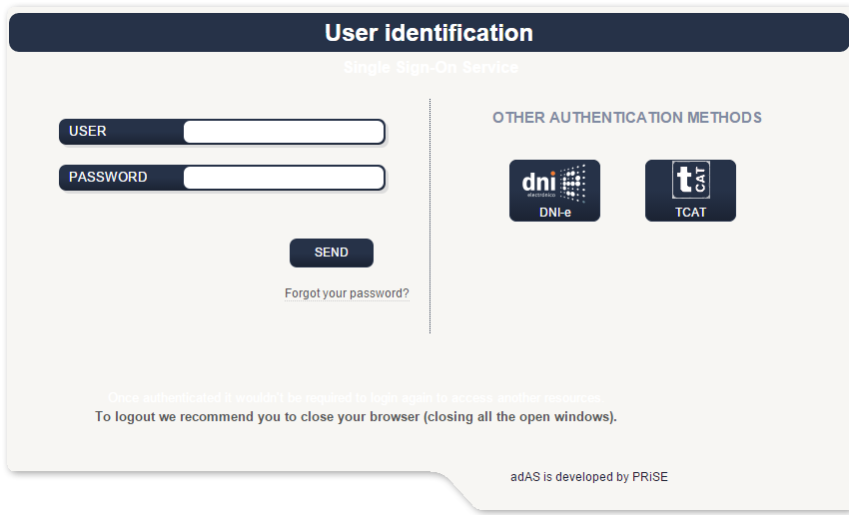
Username & Password

Slide 8
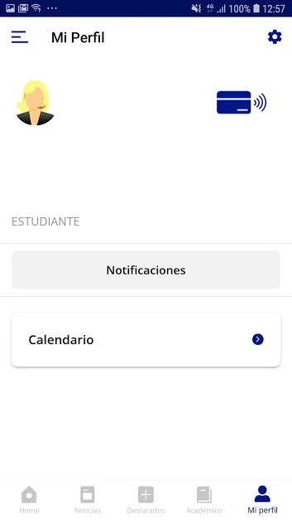
How to get the ID card?
Access to App Store/Google play and search: UDG APP
Install udg app and open it
Press the access button and write your UdG's code
Follow the indications in order to sign in
Drag the screen to the right where there's an image of a virtual card (this card is your UDG IDENTITY CARD)
https://www.udg.edu/ca/viu/serveis-universitaris/carnet-destudiant

Slide 9
Registration of subjects
Deadlines
Registration: ASAP (As Soon As Possible)
Changes: until September 22nd
24 hours later in your Moodle

Slide 10
Final Documents
Transcript of Records (ToR): you can get it from February 28th. For academic year students from July 12
The Transcript of Records (ToR) will be sent to you and to your university by e-mail.
The attendance certificate: you need to communicate the date you will leave in the email of the International Office ( incoming.oi@udg.edu ), so you can get it maximum 3 days before you leave.

Slide 11
Thank you very much!
Enjoy your International mobility experience in our Faculty of Law.
secretaria.dretieconomiques@udg.edu

